Slide 1
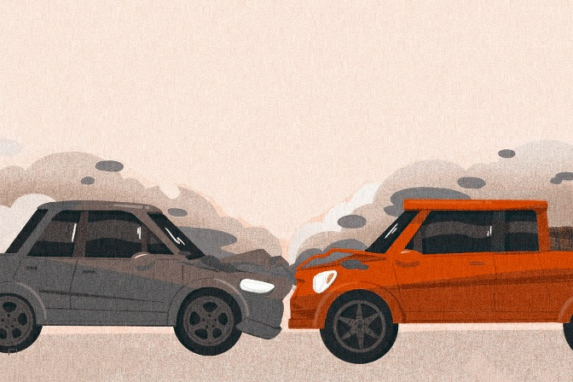

Motor Vehicle Collisions - Person
The Fatal Occurrences
DAB 201 - Data Visual and Reporting

Slide 2
Why did we pick this data?
In metropolitan areas, motor vehicle crashes are a primary cause of injury and death. Collisions can occur between pedestrians, motor vehicles, and other road users such as cyclists.
The vehicle, the occupant's state, and the organs within the occupant's body are the three types of impacts that occur. Aside from that, we may not be aware that every collision has a few other important features, such as ejection following the collision, complaints, incident time and date, and so on.
We can proceed to discover the reason or causes of an accident (which could have a single or numerous outcomes) after the collision visual analysis in order to prevent future accidents. It's a part of the accident or event investigation process.

Slide 3
Data Source
We took data from NYC | OpenData which is free public data published by New York City agencies and other partners.
https://data.cityofnewyork.us/Public-Safety/Motor-Vehicle-Collisions-Person/f55k-p6yu
It's data from a 2021 collision in New York between a person and a motor vehicle. Only injuries or deaths that cost more than $1,000 were eliminated. The date and time of the occurrence, as well as the location of the injury and the police description, are all documented.

Slide 4
CRASH_DATE
CRASH_TIME
PERSON_INJURY | Injured, killed, unspecified
PERSON_AGE | Automatically calculated based on date of birth
BODILY_INJURY | Injured body area (i.e. head, face, neck, etc.)
SAFETY_EQUIPMENT | Safety equipment being used (i.e. lap belt, harness, child restraint, air bag, etc.)
PERSON_SEX
PERSON_TYPE | Bicyclist, Motor Vehicle Occupant, Pedestrian
PED_LOCATION | Location of the pedestrian (i.e. at intersection, not at intersection)
CONTRIBUTINGFACTOR2 | Factors contributing to the collision for designated vehicle
EJECTION | Not ejected, partially ejected, or ejected from the vehicle
COMPLAINT | Type of physical complaint (ex. Concussion, severe burn, severe bleeding, etc.)
EMOTIONAL_STATUS | Apparent death, unconscious, semiconscious, etc.
VEHICLE_ID | Unique vehicle record associated with person. Foreign Key to the vehicle table
PERSON_ID | Person identification code assigned by system
CONTRIBUTINGFACTOR1 | Factors contributing to the collision for designated vehicle
POSITIONINVEHICLE | Seating position #1-#8 (i.e. driver, front passenger, etc.)
PED_ROLE | Pedestrian, witness, in-line skater, other, etc.
UNIQUE_ID | Unique record code generated by system. Primary Key for Person table.
PED_ACTION | What the pedestrian was doing at time of crash (i.e., walking with the signal, against the signal, etc.)
COLLISIONID | Crash identification code. Foreign Key, matches unique_id from the Crash table.

Slide 5
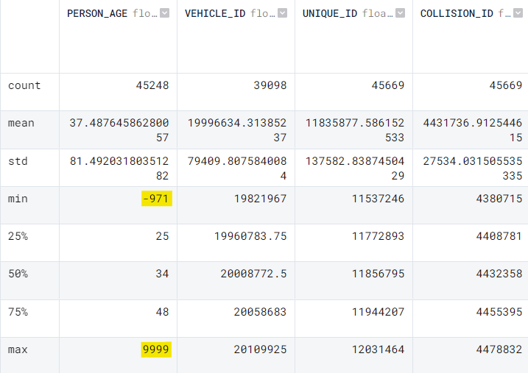
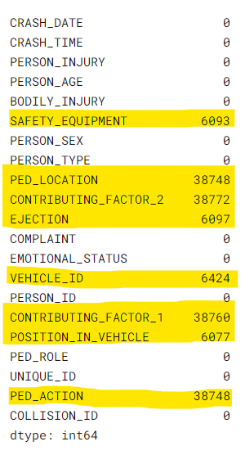
Challenges with the data
Invalid Person Age
Null Values in data

Slide 6
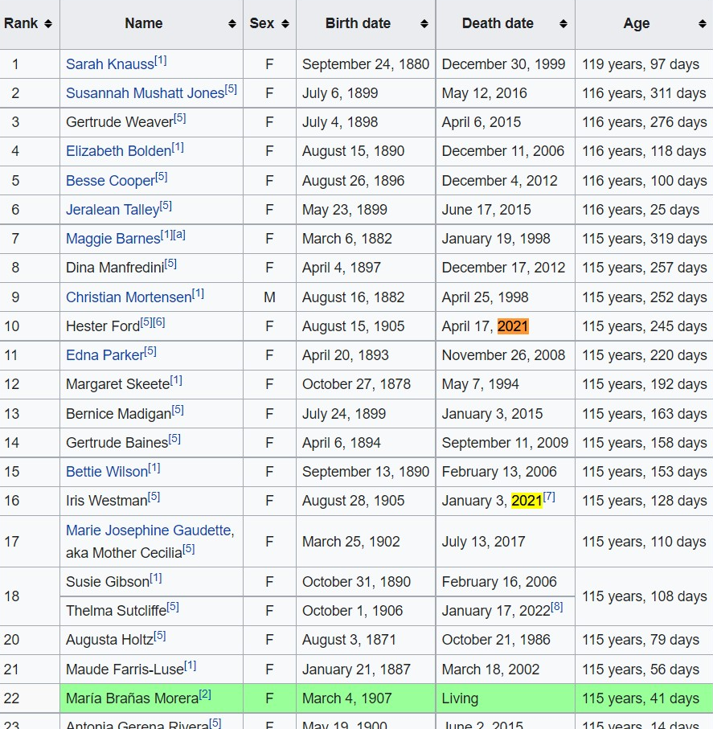
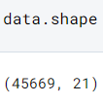
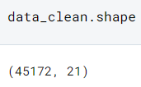
Data Cleaning
American Supercentenarians in 2021

Slide 7
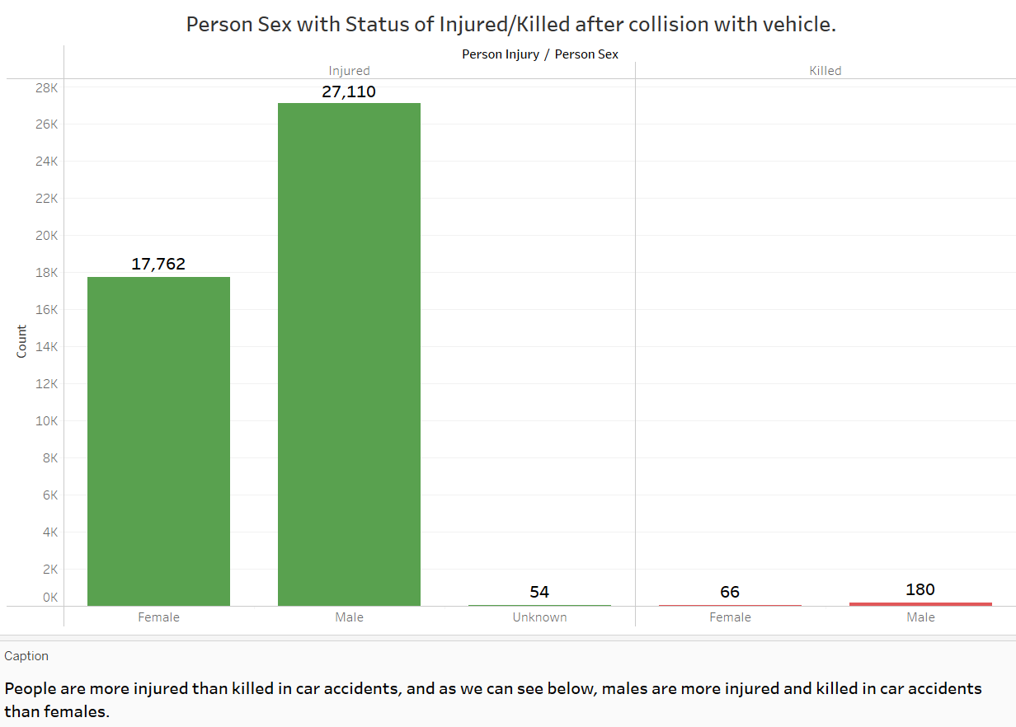


Slide 8
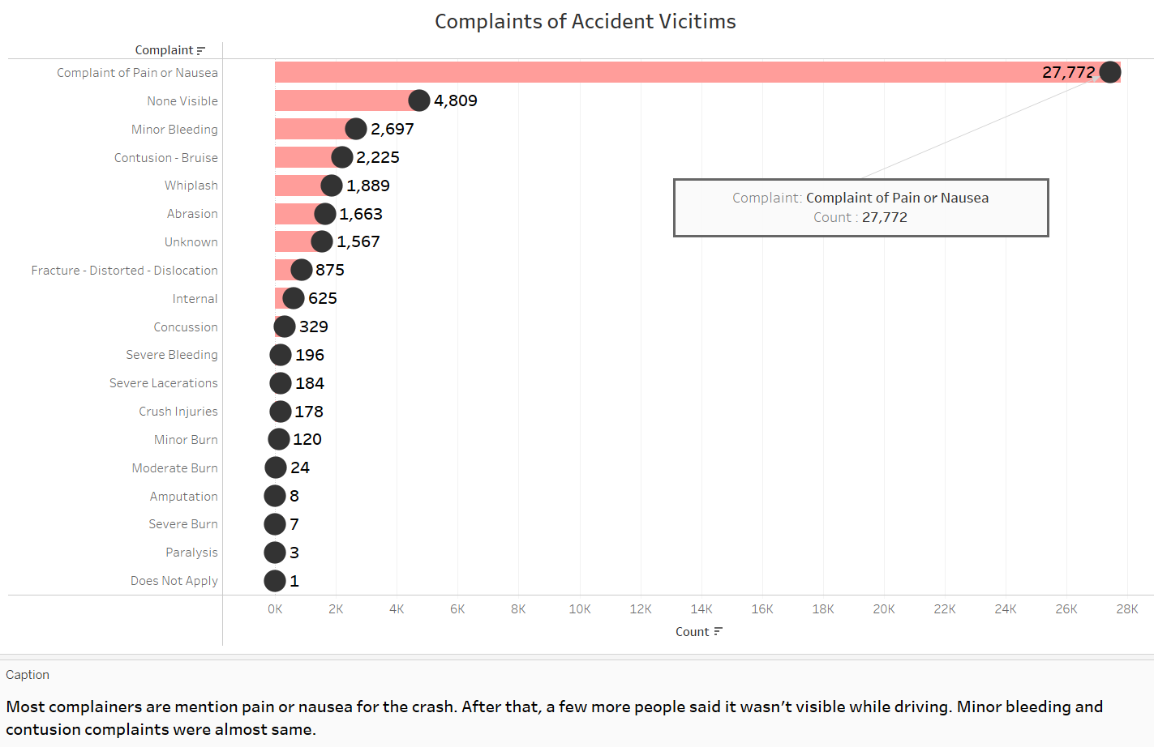

Slide 9
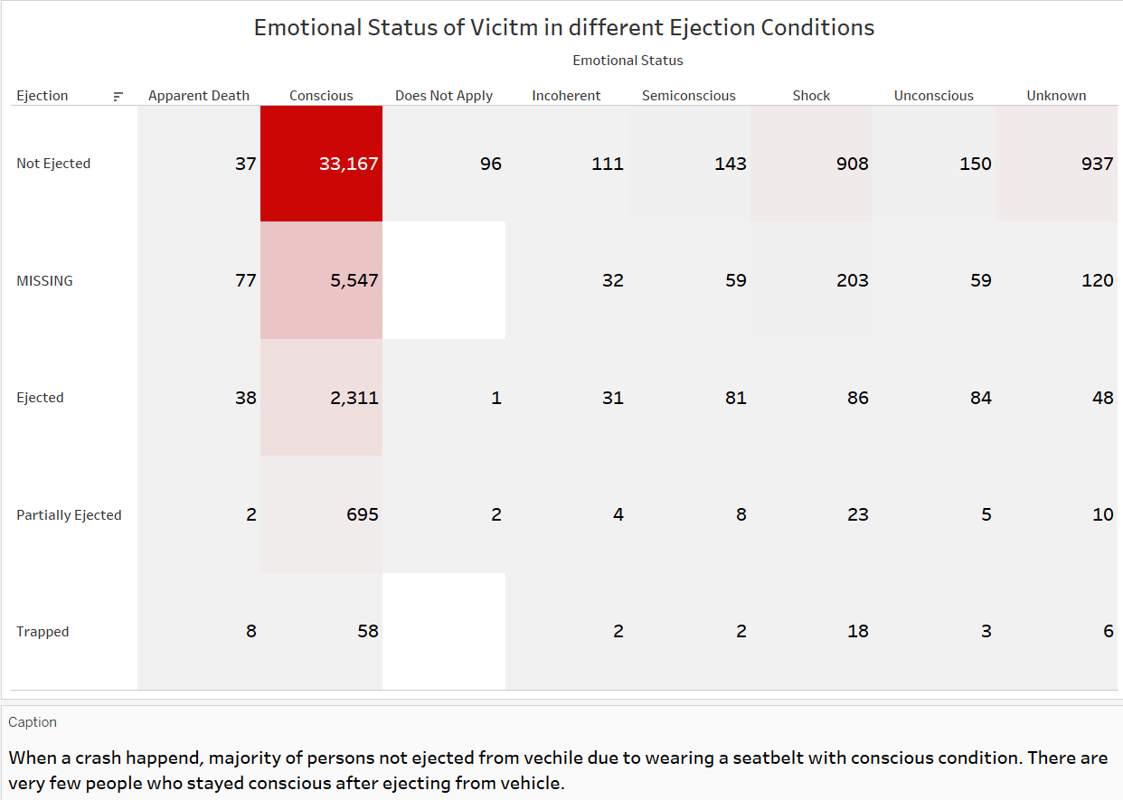

Slide 10
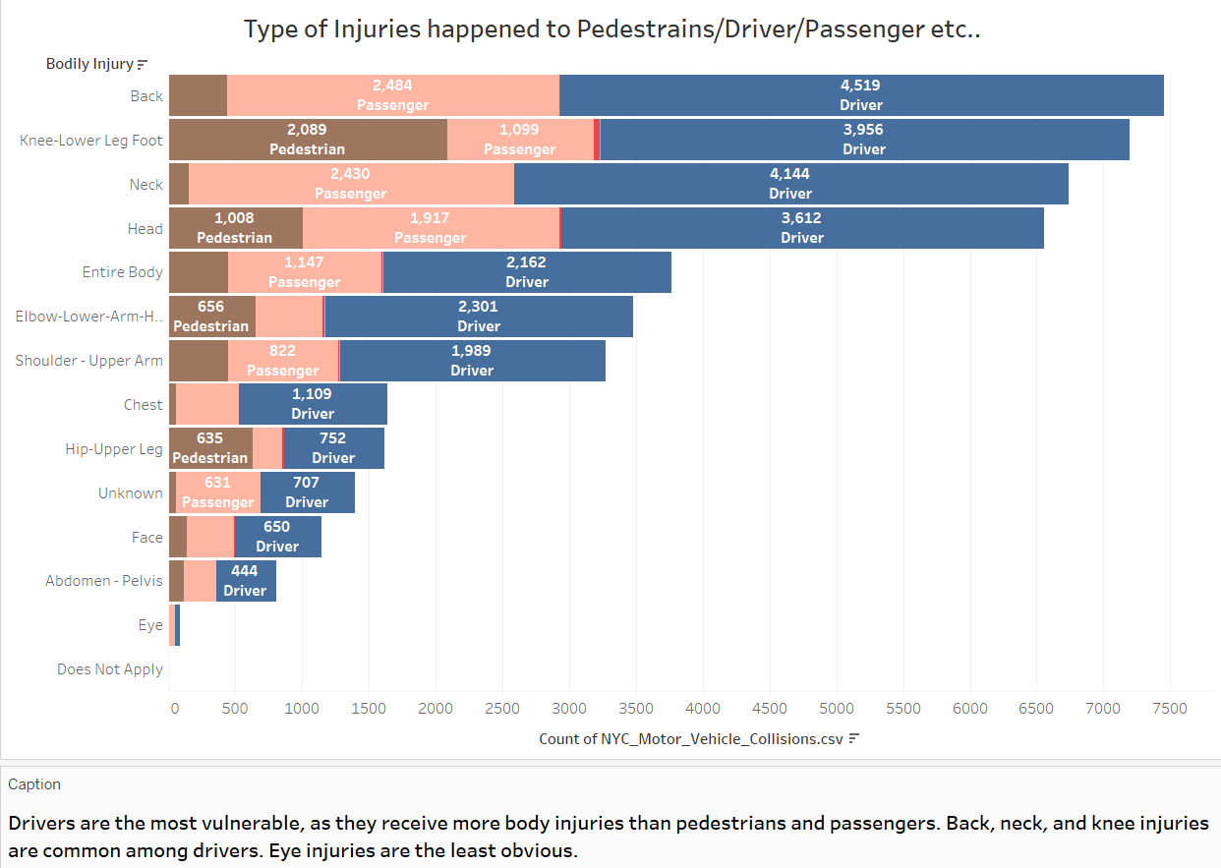

Slide 11
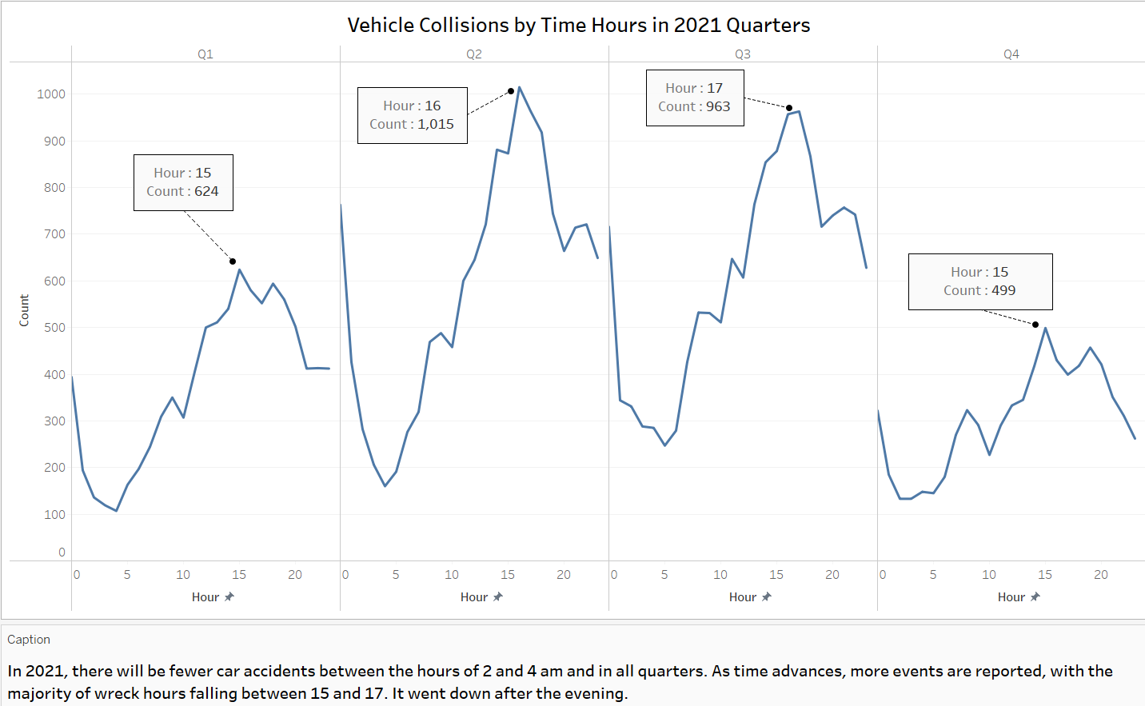

Slide 12
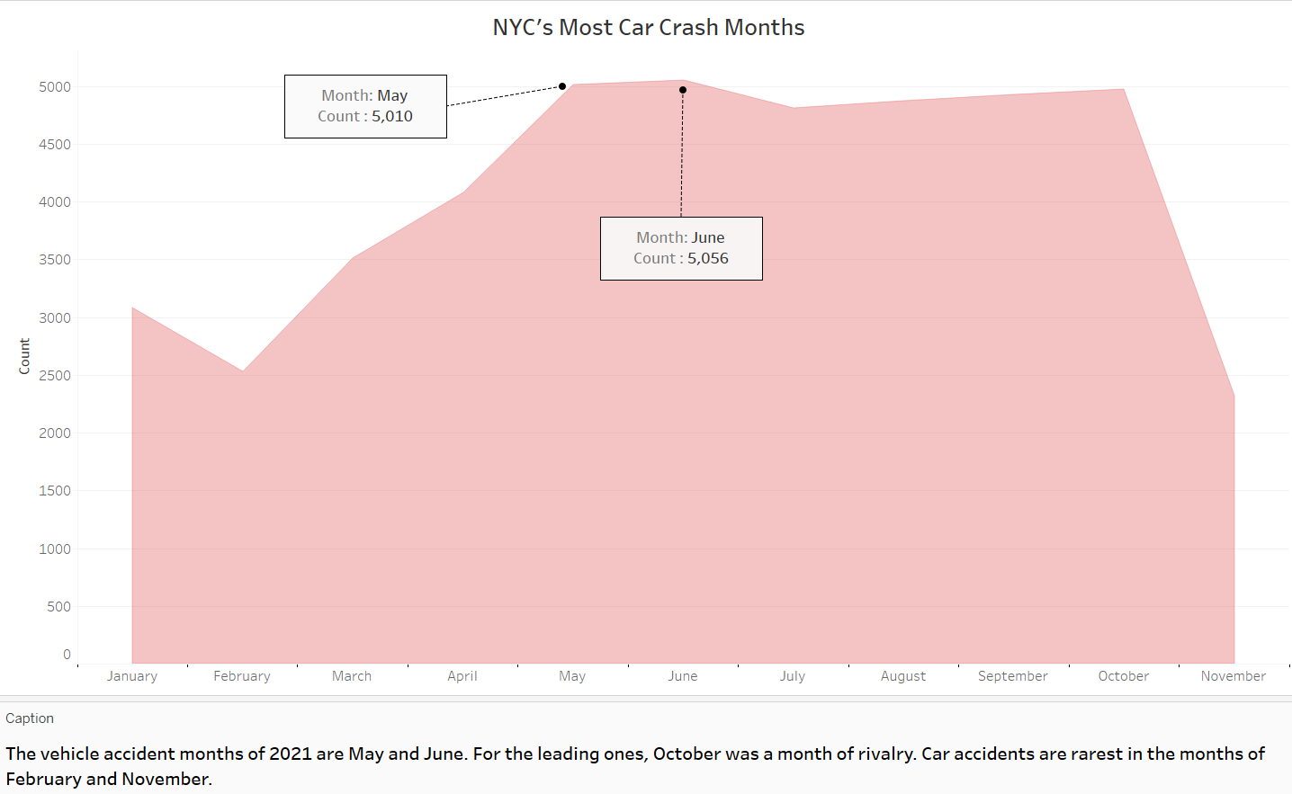

Slide 13
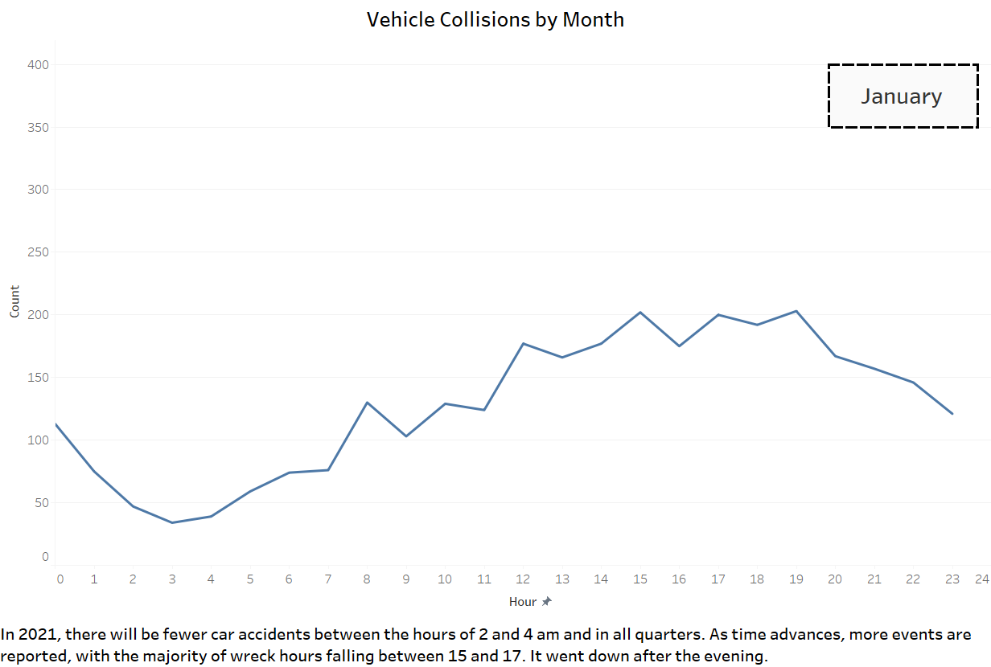

Slide 14
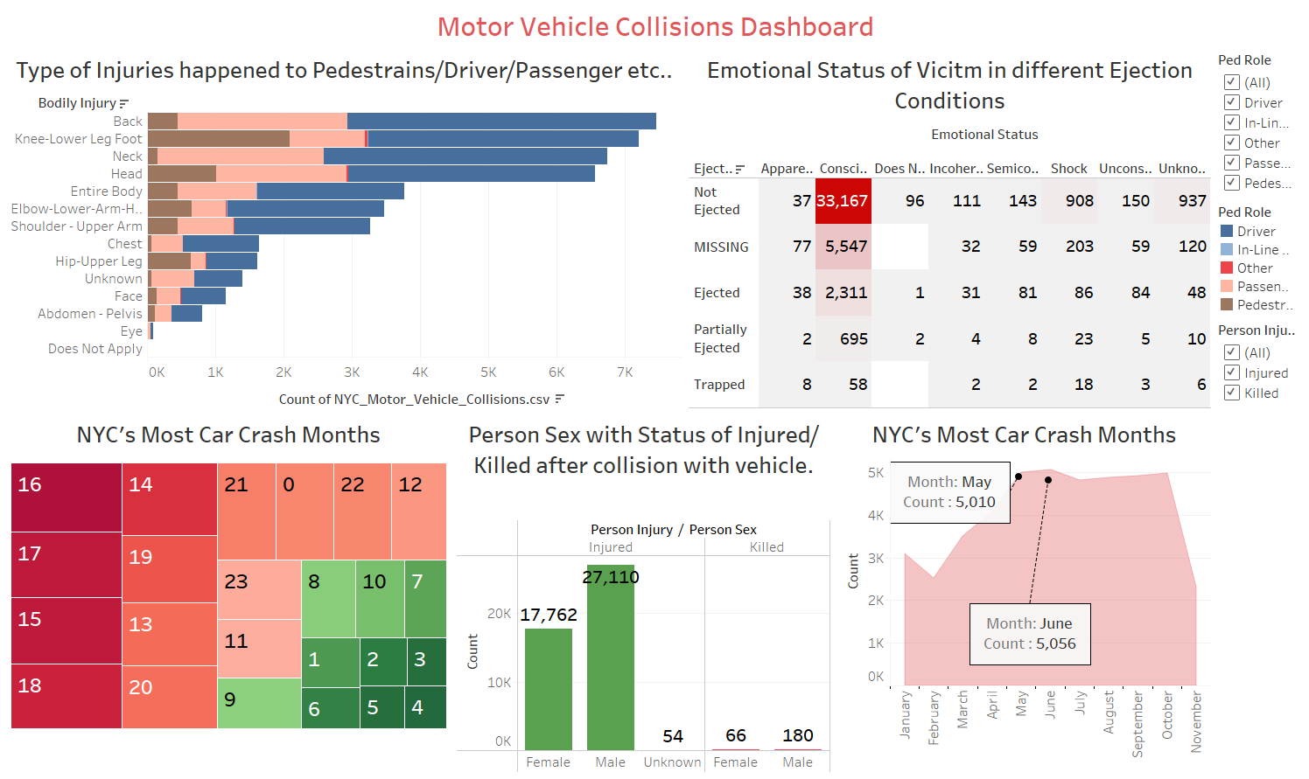

Slide 15
Data Insights
In car accidents, more people are hurt than killed, and males are more injured and killed in car accidents than females. Most complainers blamed the crash on pain or nausea.
When a crash occurs, most people are not thrown from the vehicle because they are wearing a seatbelt and are conscious. (this is a favorable indicator)
Drivers are the most vulnerable, as they receive more body injuries than pedestrians and passengers. Back, neck, and knee injuries are common among drivers.
Between the hours of 2 and 4 a.m., there are car accidents in all directions. More occurrences are reported as time goes on, with the majority of wreck hours coming between 15 and 17. After the evening, it dropped down.
The months of May and June in 2021 are the most likely to be involved in a vehicle accident.

Slide 16
Thank You

